Slide 1

Power Apps

Slide 2
Introduction
Power Apps is a suite of apps, services, and connectors, as well as a data platform, that provides a rapid development environment to build custom apps for business needs. Using power apps, you can quickly build custom business apps for phone and tablet that connect to your data stored either in the underlying data platform (Microsoft Daraverse) or in many online and on-premises data sources. App built using Power Apps provides rich business logic and workflow capability to transform manual business operations into digital, automated processes.
https://make.powerapps.com/

Slide 3
Variety of Data Sources to create Power apps

Slide 4
Microsoft 365 Data Sources
SharePoint: Connect to SharePoint lists and libraries.
OneDrive for Business: Access files stored in OneDrive.
Microsoft Dataverse: A cloud-based data platform to securely store and manage data.
Excel: Upload and access Excel files from OneDrive or SharePoint.
Teams: Integrate with Teams data to build collaborative apps.
Power Automate: Automate workflows and trigger actions from Power Apps by connecting to data sources in Power Automate.
Outlook: Access email, calendar, and contact data from Outlook.

Slide 5
Common Data Service (Dataverse)
Dataverse (formerly known as CDS) is the unified data platform that allows you to store and manage business data across apps. It's a central hub for relational data, integrated with other Microsoft applications.

Slide 6
Cloud Services
Google Sheets: Use data stored in Google Sheets (via third-party connectors).
Dropbox: Integrate with Dropbox to access and manage files.
Azure Table Storage: A NoSQL key-value store in Azure.

Slide 7
SQL-based Data Sources
SQL Server: Connect to on-premises or Azure SQL databases.
Azure SQL Database: Cloud-hosted SQL databases.
MySQL: Connect to MySQL databases.
PostgreSQL: Integrate PostgreSQL databases with Power Apps.

Slide 8
Ways of Creating Power Apps
Canvas Apps: Canvas apps allow you to design the app’s interface by dragging and dropping elements onto a blank canvas, giving you full control over the user experience and layout.
Model-driven Apps: Model-driven apps are built around your data model and business processes. You define entities and relationships in Dataverse, and Power Apps generates the user interface based on those models.
Power Apps Studio: Power Apps Studio is the primary tool to create both canvas and model-driven apps. It’s an integrated environment where you can design, test, and deploy your apps.

Slide 9
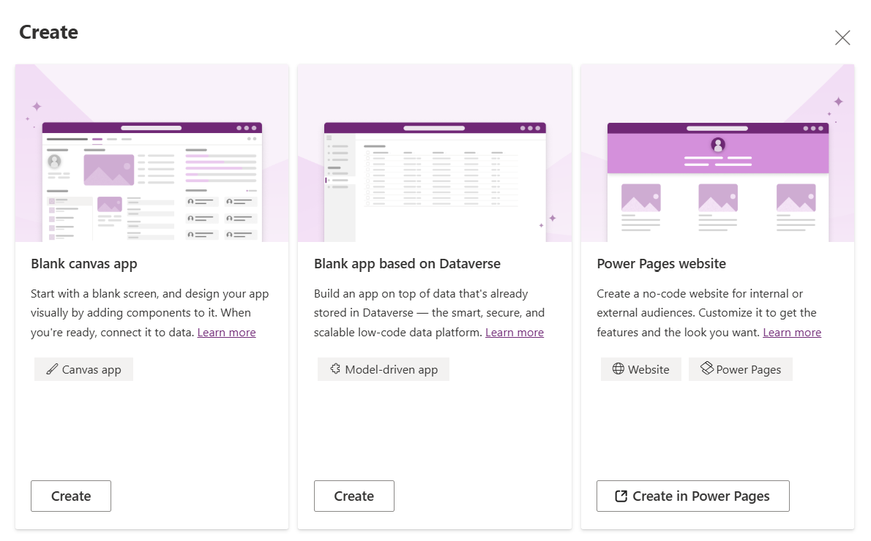
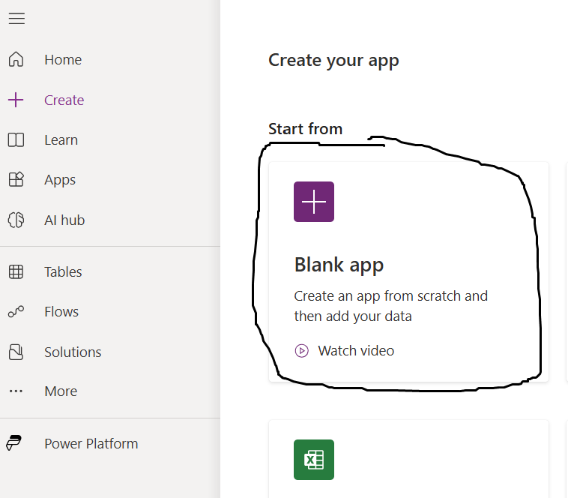

Slide 10
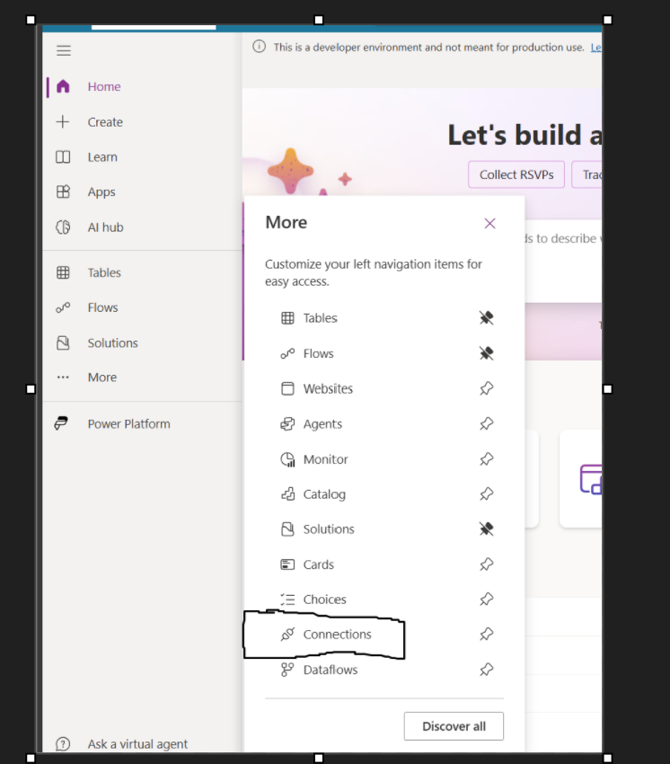
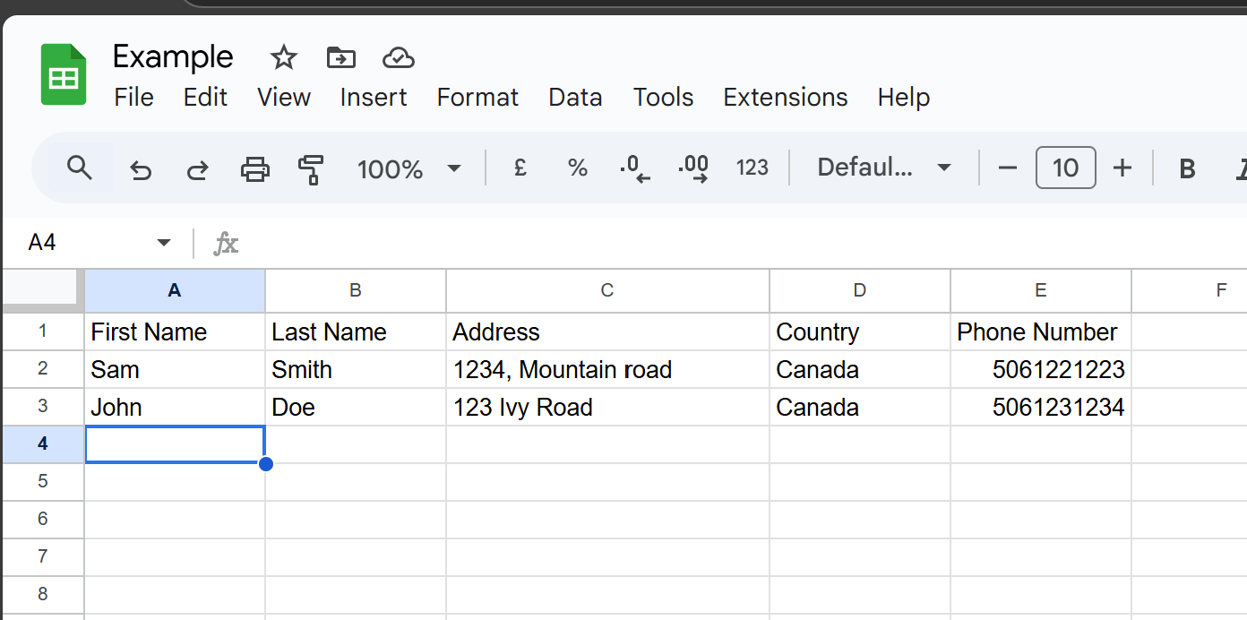
How to link a data external (Google Sheet)
We would be working with empty google sheet and we would link it as our data source in power apps.
Create a blank document

Slide 11
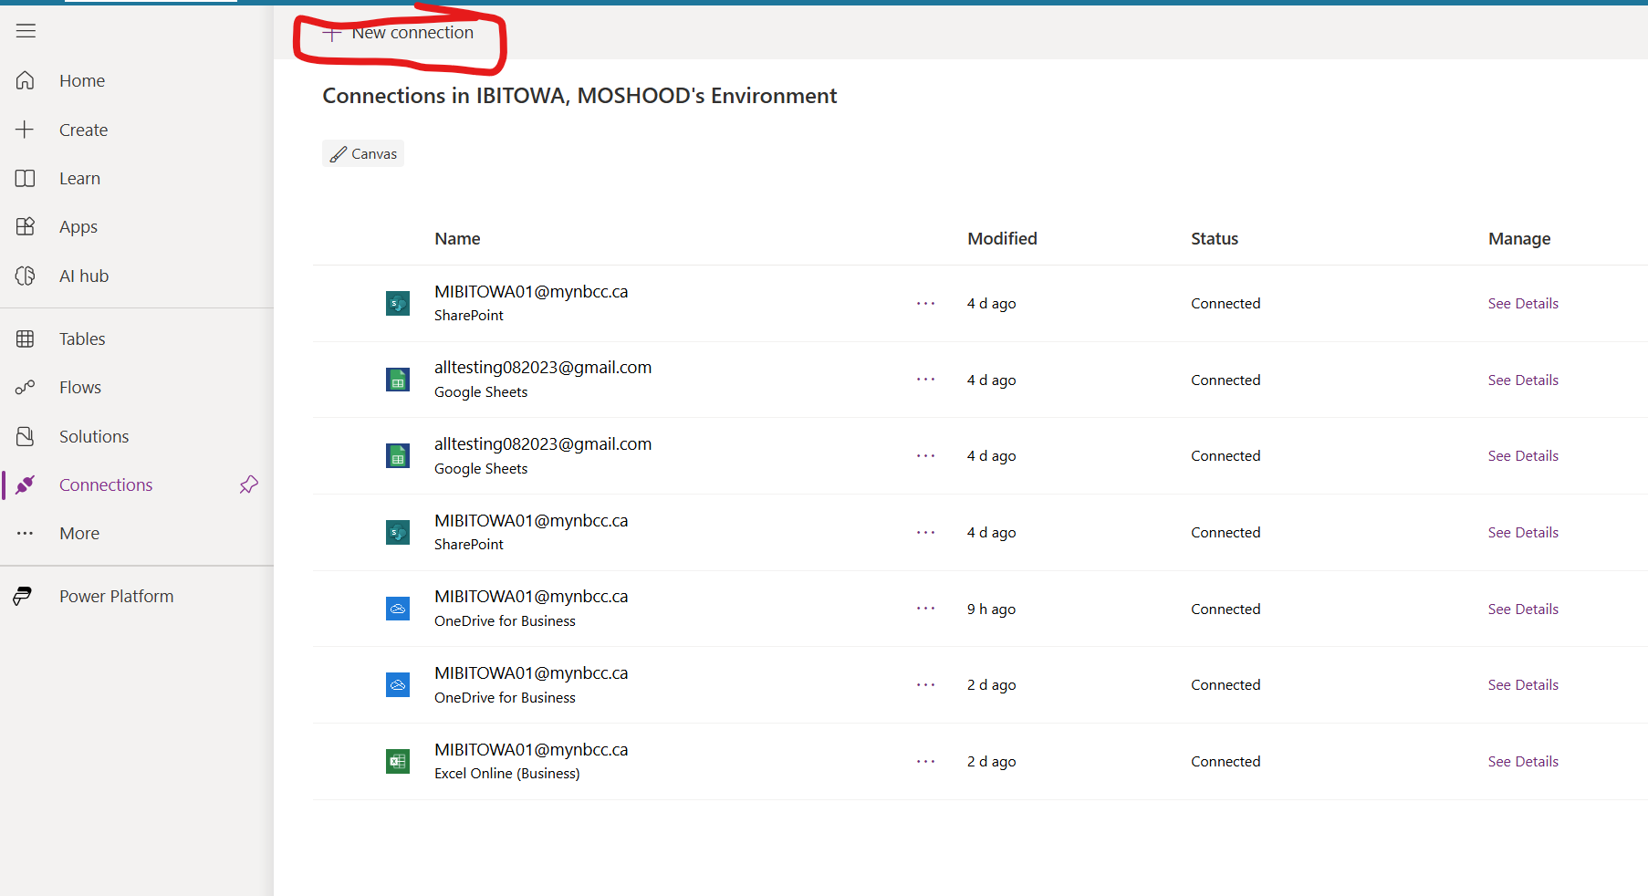
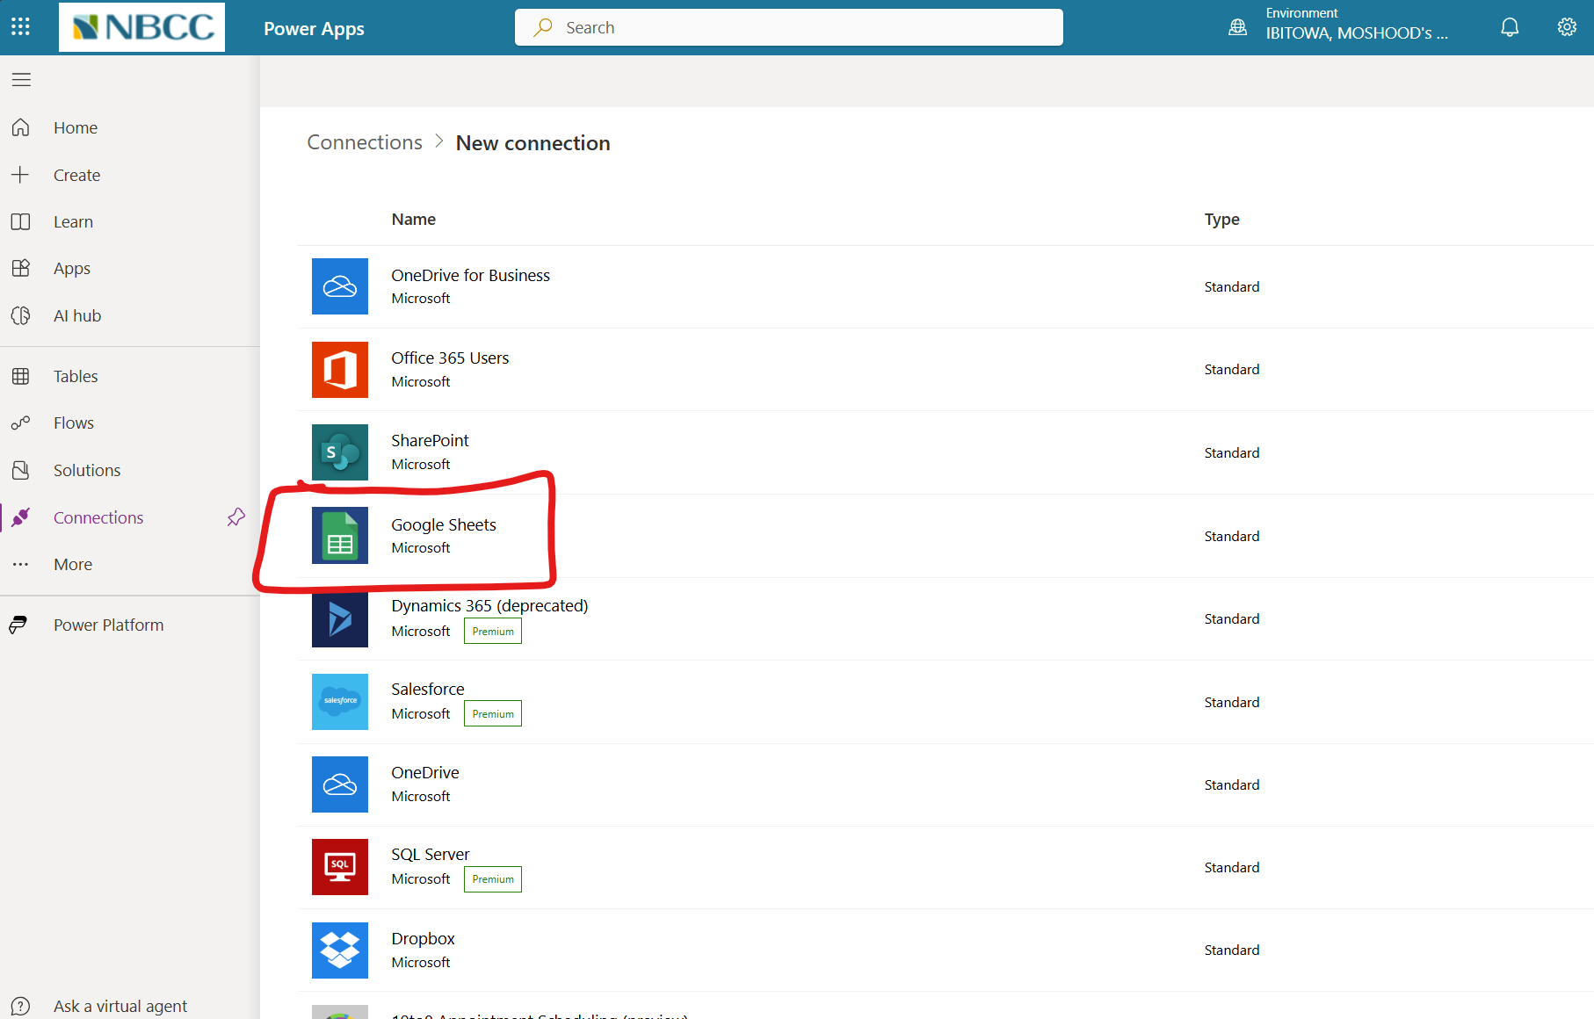

Slide 12
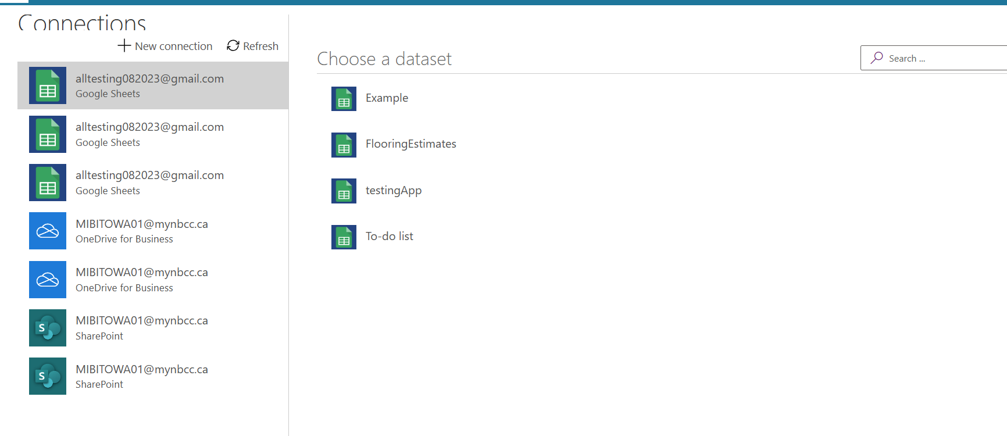
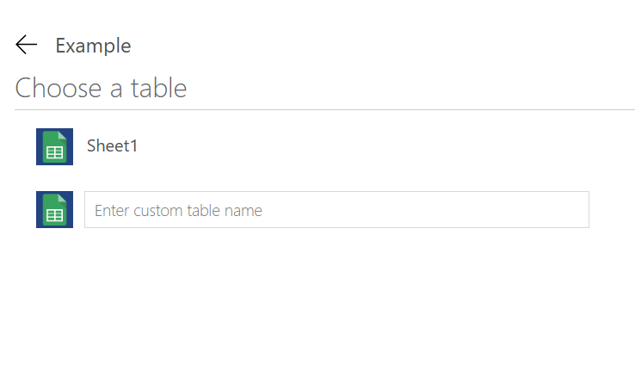

Slide 13
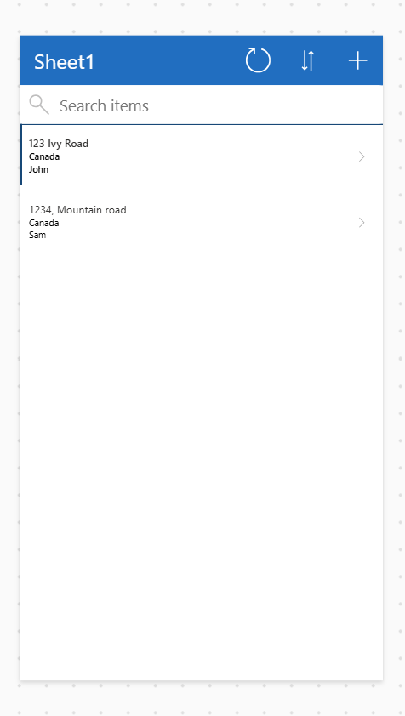
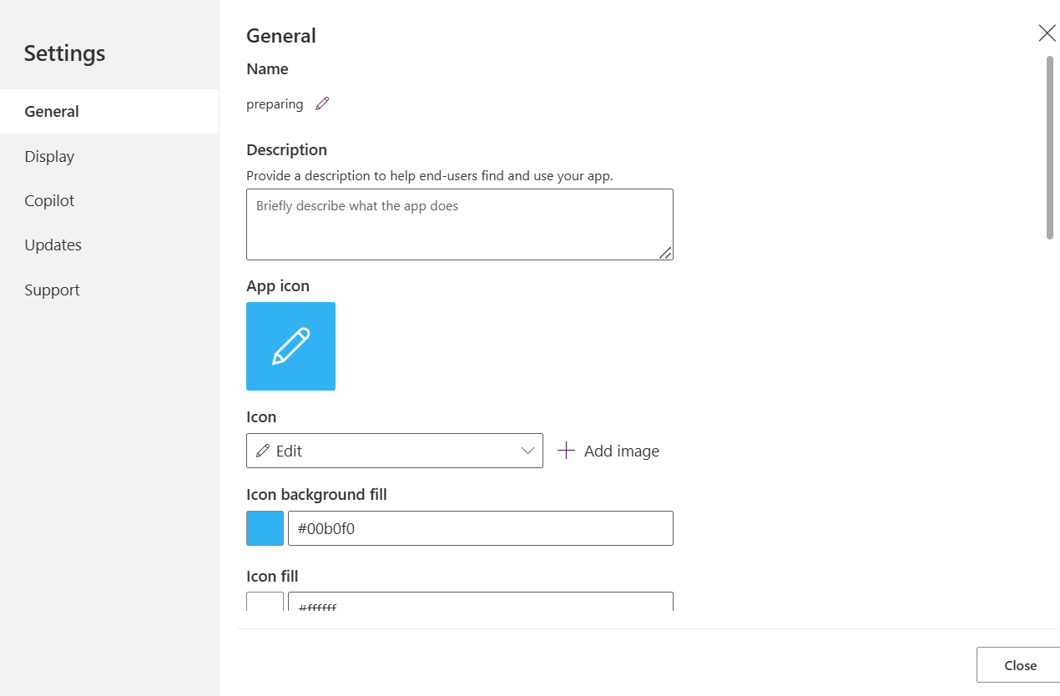
Note icon for app can only be 240 * 240

Slide 14
Variable
There are three type of variable declaration in power app. Contextual(Context), Global and collection variable

Slide 15
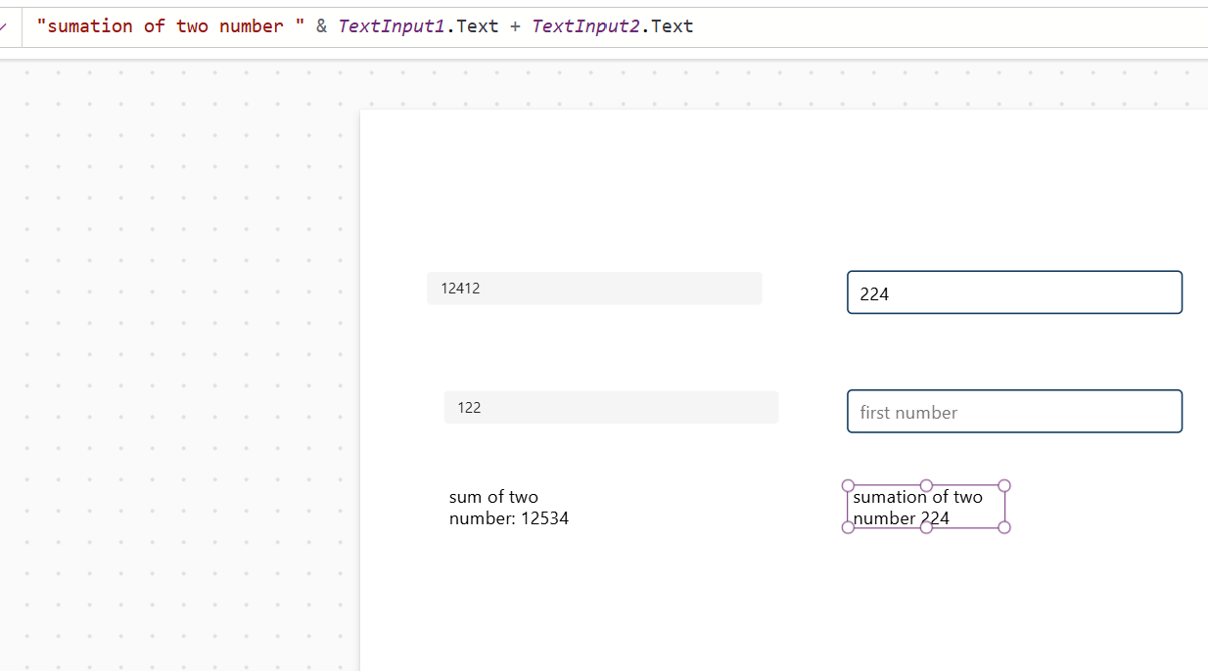
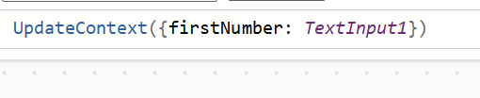
Contextual Variables

Slide 16
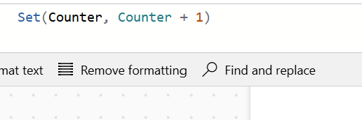
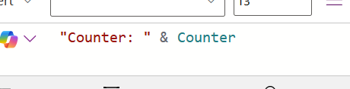
Global

Slide 17
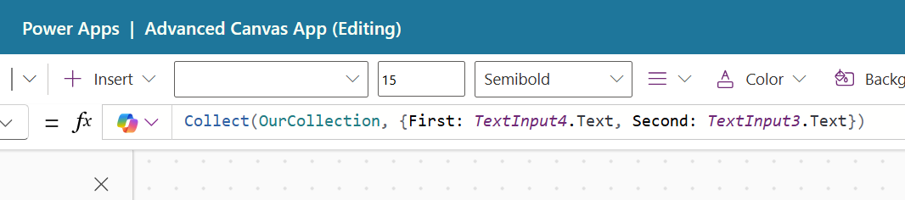
Collection variable

Slide 18
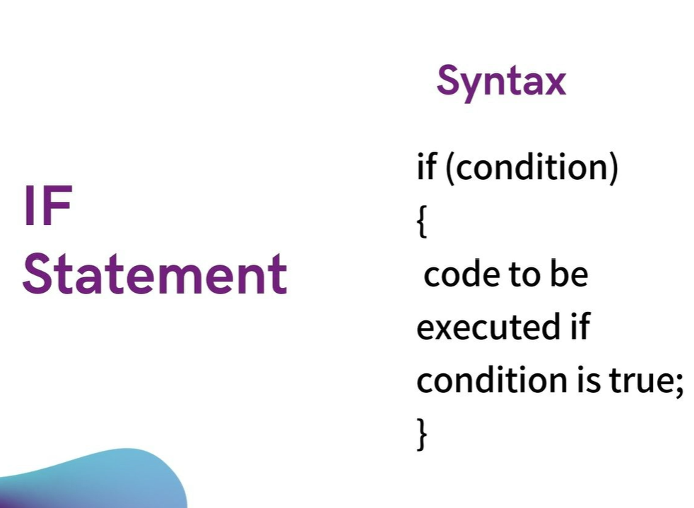
Uploading an Excel file and if statement

Slide 19
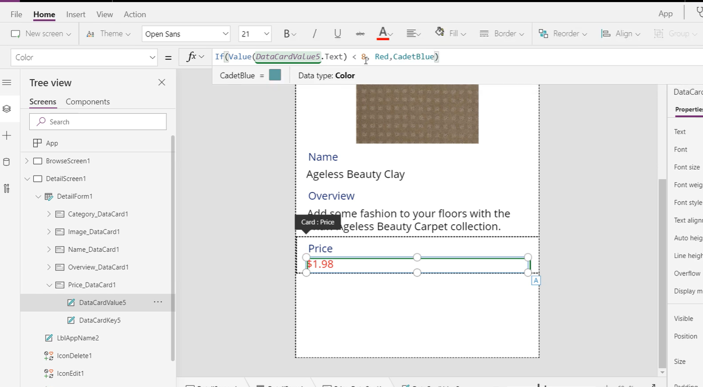

Slide 20
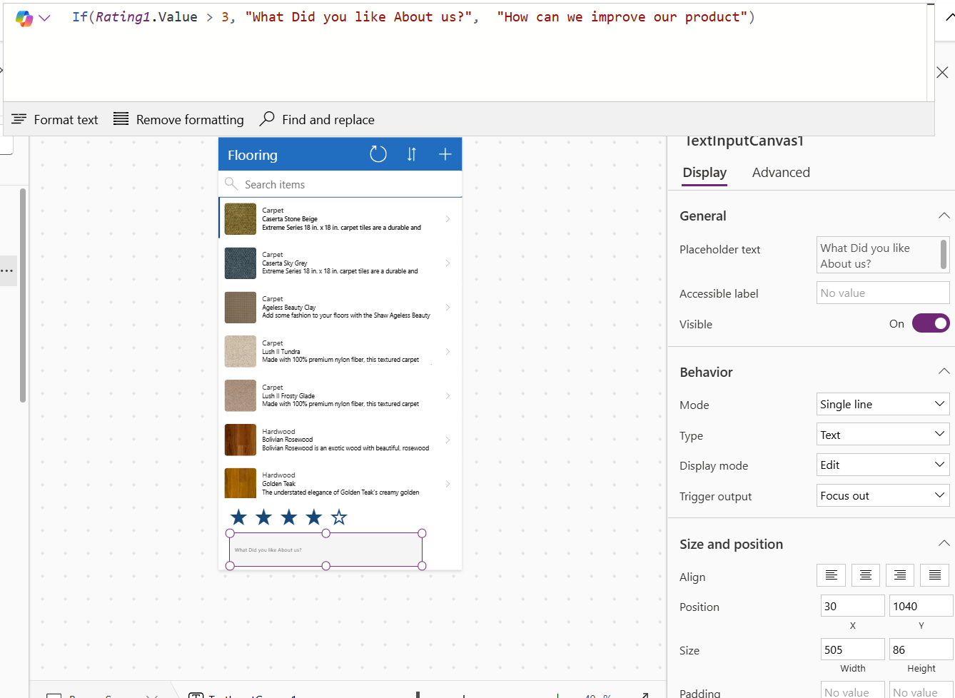

Slide 21
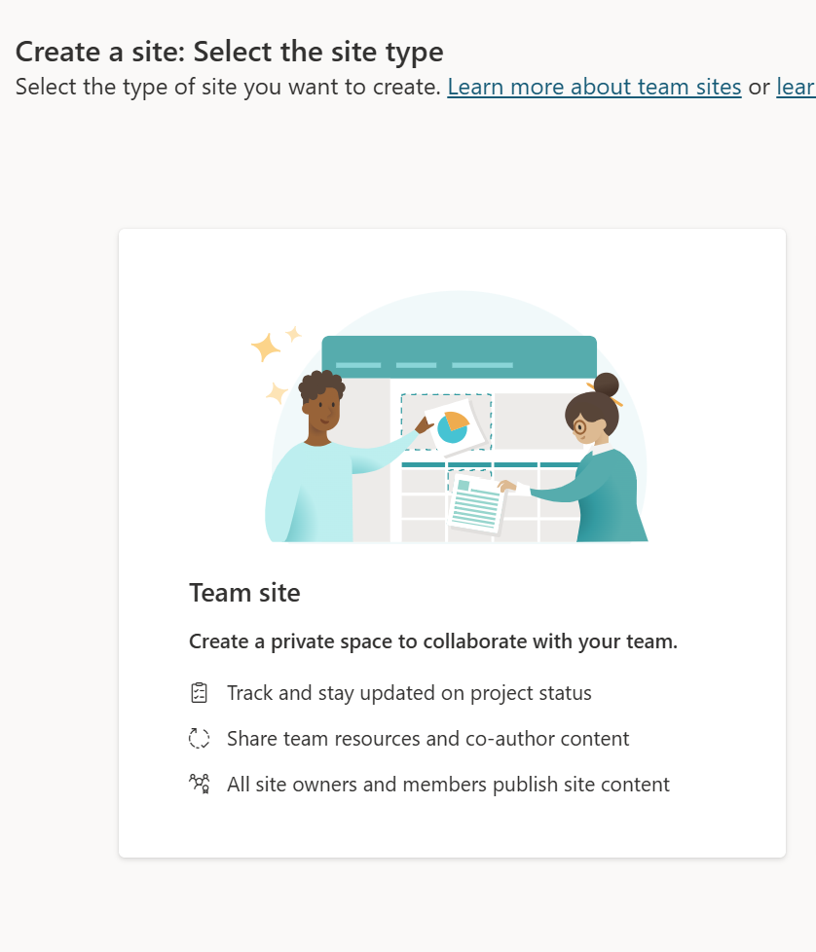
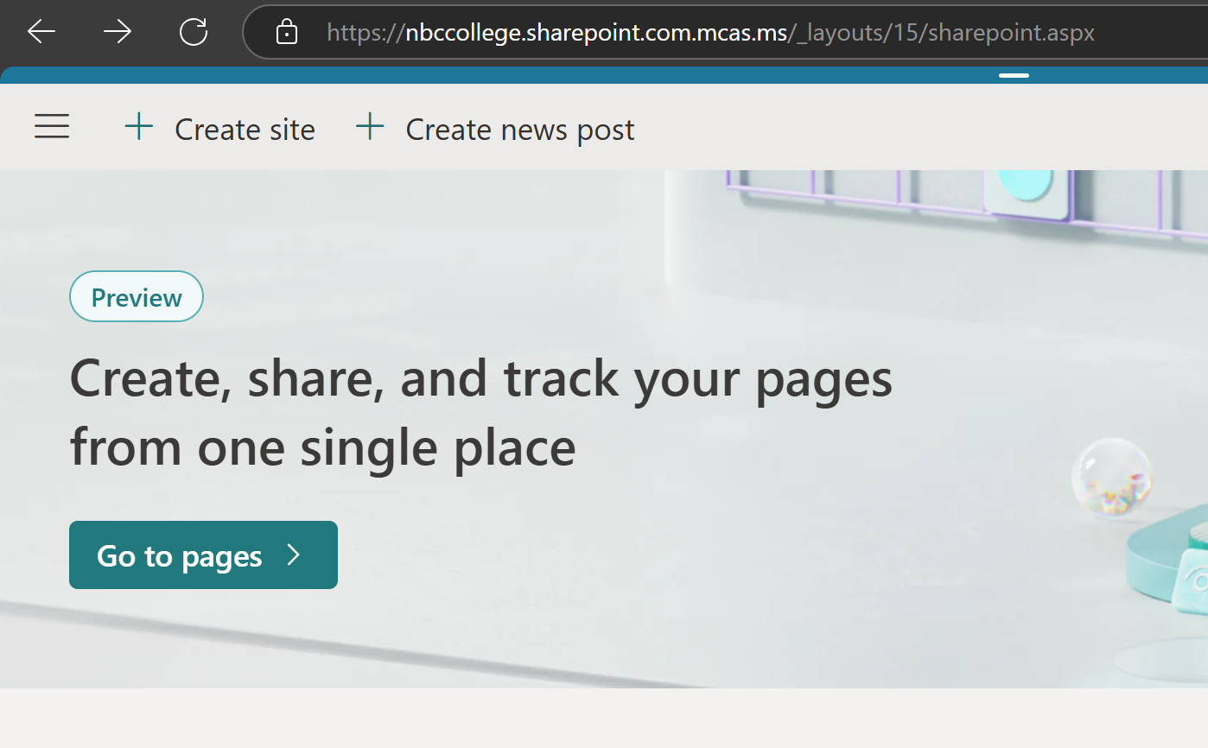
Using SharePoint

Slide 22
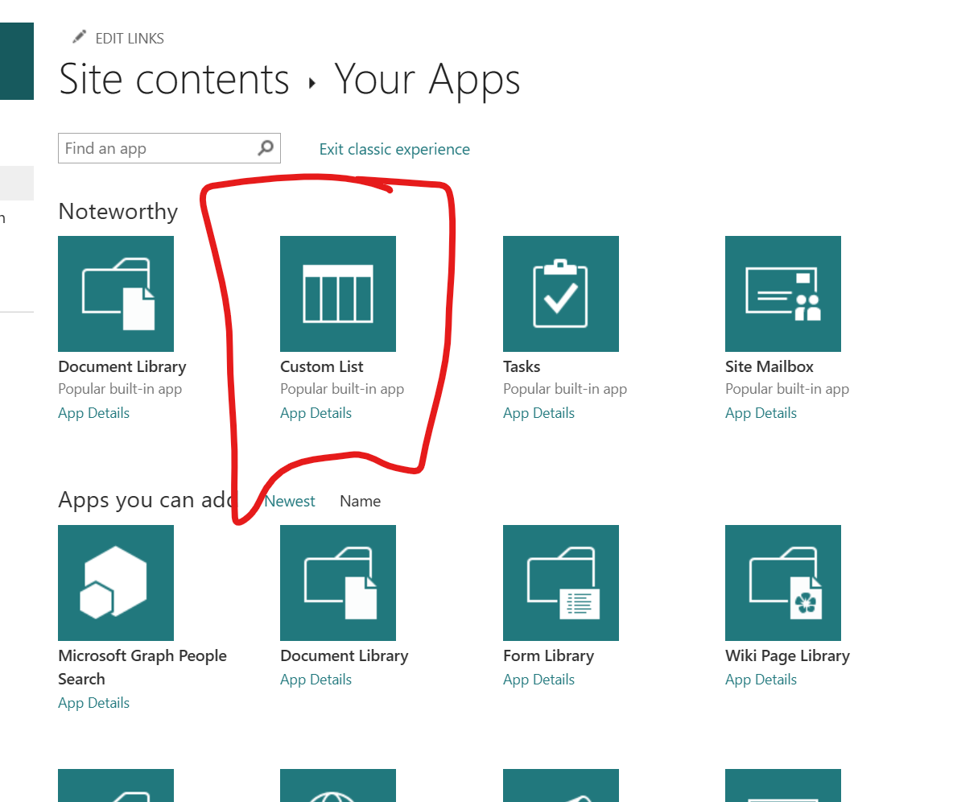
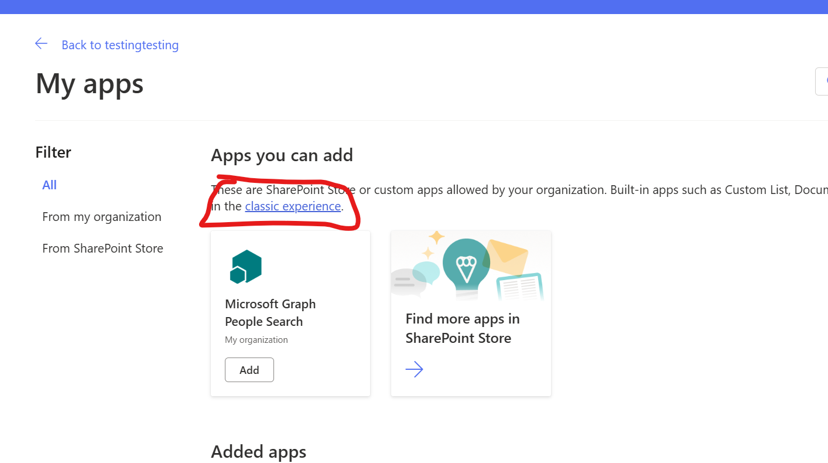

Slide 23
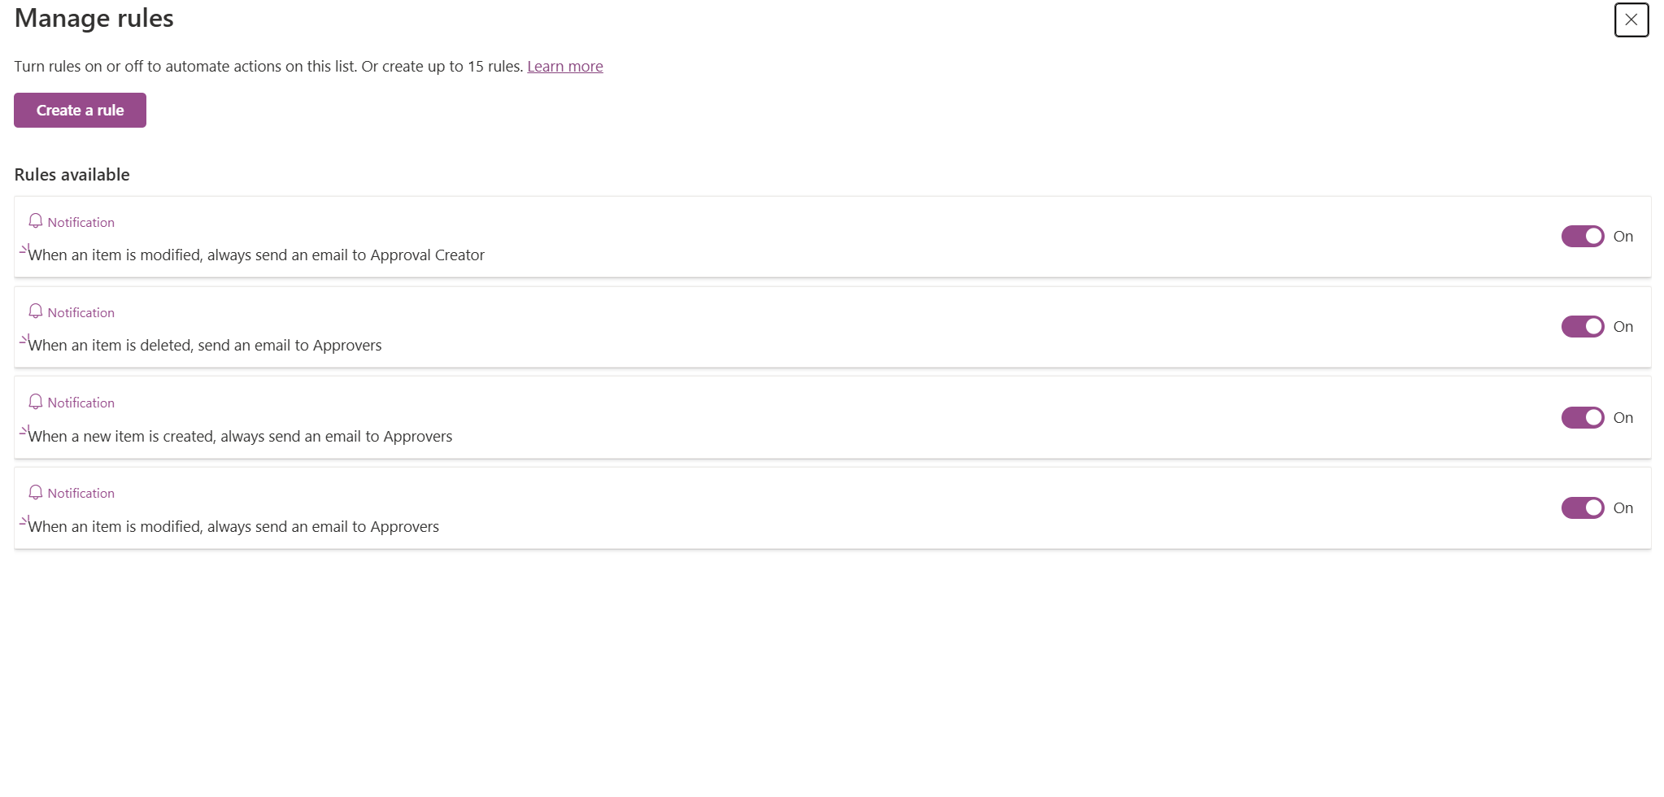
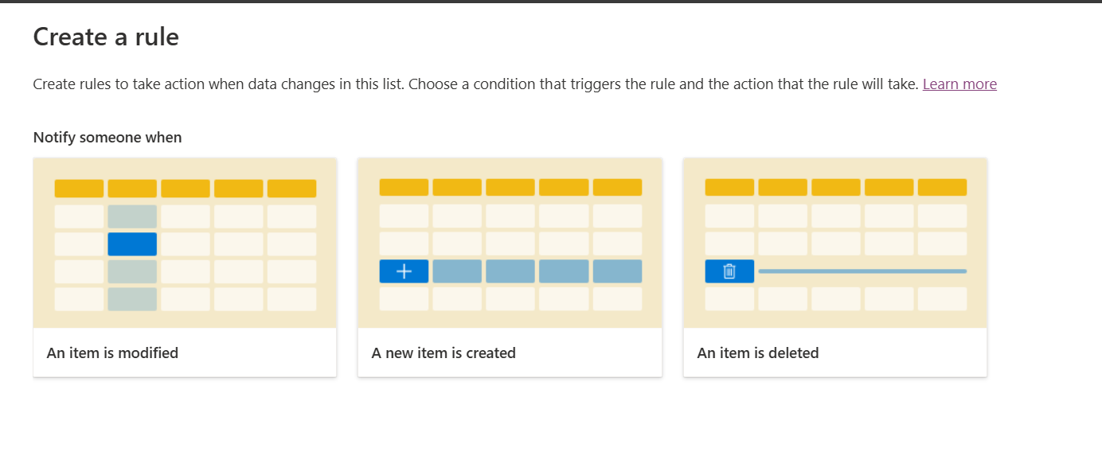
Adding Rules in a List

Slide 24
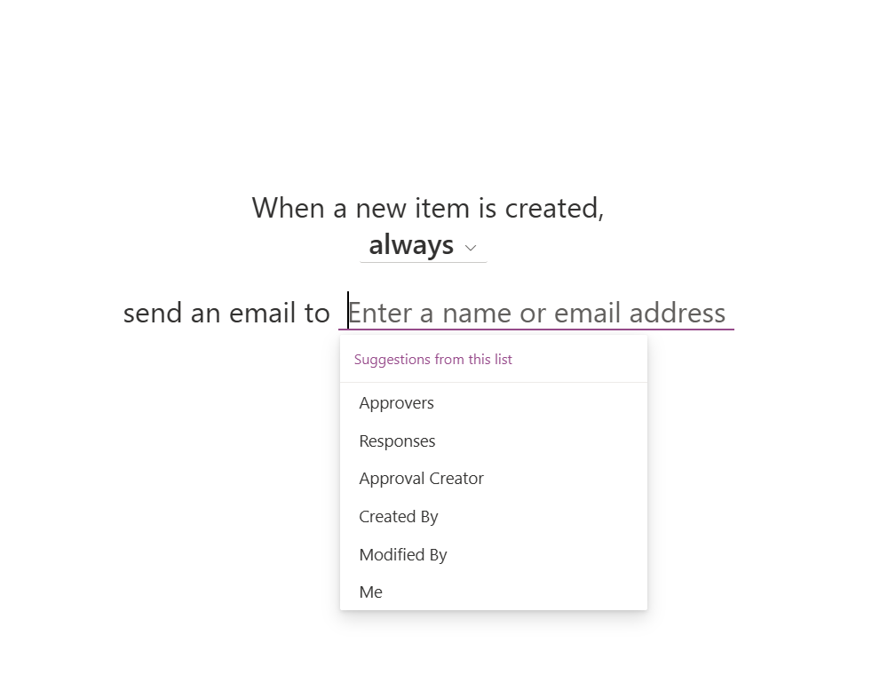
Role Based Access Control

Slide 25
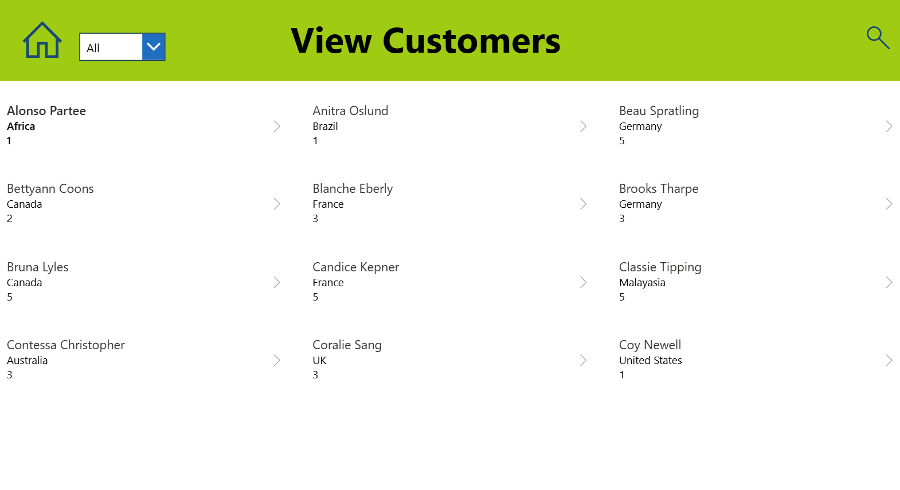
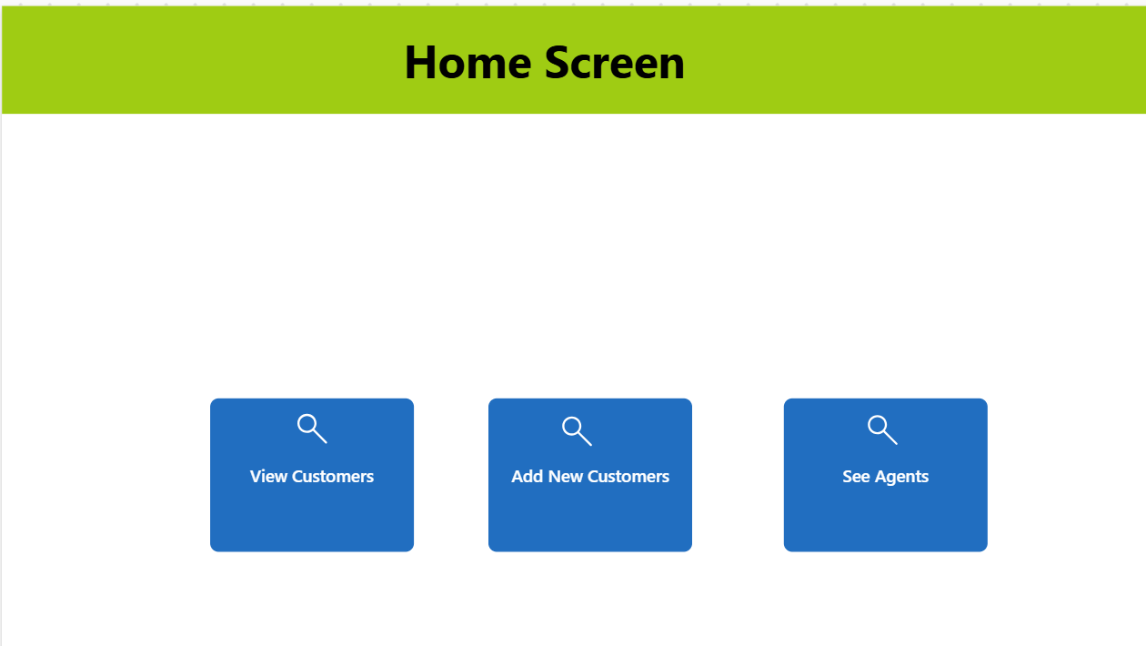
Building with Blank Canvas

Slide 26
Materials used
Reference: Official Microsoft Power Apps documentation - Power Apps | Microsoft Learn
Udemy: https://www.udemy.com/share/105HdY3@rfpouC3vzlZRe4g09iKoNAUfIDTkOCuSF9VxebmlwUzjfa6D7Vadk9eP1OG6hrKK-A==/

